Slide 1
Service Mesh
Notes:
The aim of this presentation is to give you some introductory knowledge about the concept of a service mesh. You have probably done some reading and other research on the concept of microservices, what they are, and how they relate to other application models. You may know a little or a lot, but as long as you know something, you should be fine following what I have to say. Microservices mesh include a set of functions that can help to address some of the challenges that microservices present.

Slide 2
Agenda
Why service mesh?
Common functions of a service mesh
Services mesh implementations
Notes:
In this 3 part presentation, I will first define the set of challenges we are talking about. After that, I will describe, in general and hopefully simple terms, the most common set of functions that are typically provided by a microservices mesh, so you have some way to understand and compare the various options out there. In the third segment, I will give an introductory but somewhat more detailed description of different mesh you could use.

Slide 3
Why Service Mesh?
Notes:
So we will get started now addressing the question of why services meshes were built and why they are useful.

Slide 4

Why Service Mesh?
In monolithic applications, the location of resources used are:
Well-known
Relatively static
Found in configuration files or hard-coded
This is not true for a microservices implementation
Required services could be anywhere
Cloud providers, public or private, datacenter, VMs, containers, servers
Service instances have dynamic locations
Come and go because of elasticity, failures, upgrades
Microservice
Microservice
Microservice
Notes:
Given the fact that you are listening to this presentation, I expect that you have done a little or a lot of research on the subject of microservices. It is a pretty popular subject these days in the literature about cloud and there is a lot of good information out there, written and on Youtube, from Martin Fowler and others. If you have been through some of it, you will know that microservices are often defined in terms of what they are not. They are often defined as being the opposite of what we call monolithic applications. Monolithic applications are what most of us who have been around the industry for any length of time are used to. Even if a monolithic application has been divided into different tiers, for user interface, application logic, database access, and others, the location of resources used by the application tend to be well-defined and they tend to be static. Often times, all tiers of the application are hosted in the same geographical location, even if they are replicated for availability. The point is, the connections between the difference parts of the application tend to be well-defined, and they don’t tend to change very much.
This is definitely not the case with a microservices application. Whether that application is being built from scratch, or is gradually being built by breaking off functions of a monolithic application, the location of a given service could literally be anywhere. It could be in a corporate datacenter, a public cloud provider, or some combination. It could be hosted on bare metal servers, virtual machines or containers or all of the above. A given service will usually have more than one instance or copy. Instances of a service can come and go as that service scales up and down under different load conditions. Instances can fail and be replaced by other instances hosted from the same physical location or other locations. You can also have certain instances hosting one version of a service and others hosting a different version. As you are using these services in your application, where the service was the last time you used it may not be where it is now.

Slide 5
The complexity tradeoff
Hailo
Faster Independent
Deployments
Increased
Operational
Complexity

Slide 6

What are the challenges with microservices?
How can I find the service I need?
What if it moves or fails?
How can I scale my services?
Spread my load against multiple instances?
Can I control how I spread the load?
How can I test new versions of services?
Without impacting existing users
How can I test against failures?
How does the failure of one service affect the others?
Do my services have reasonable timeouts?
Can I avoid cascading failures?
Notes:
So for all the benefits that microservices provide in terms of flexibility, scalability, and resiliency, they also present some serious practical challenges. Here are just a few of them. Since a given service instance can be anywhere, and it might not still be where I found it last, how can I find the service I need and what if it is not where it used to be? Let’s say the load has increased on my application and there are now 5, 10 or 100 instances of the service I need. How do I make sure I know about all those instances available to me? How should I decide which instance my request should go to? Do I want to spread the load evenly amongst all the instances? Do I want to reserve some instances from some percentage of my requests, or do I want to reserve some for certain users, maybe my premium users? Can I test a new version of a service in some instances while keeping other instances at the production version? Can I decide which users to send to the new version? How can I make sure my application can withstand the failure of one or more of the services it relies on, without failing or hanging the whole application? For all the benefits, there are some tradeoffs in the form of additional complexity when you are using microservices.

Slide 7





A service mesh can help
These are common challenges for everyone creating microservices
Don’t reinvent the wheel
Variety of solutions using open source tools
Istio
Notes:
So now we come to the answer to the question posed in this segment, why are there service meshes. It’s because the challenges we have described briefly, and more, have already been faced by every organization that has decided to implement microservices. Several of these organizations have come up with viable solutions for these challenges, and what’s more, they have made their solutions available as open source software for others to use, improve and contribute to. So you do not have to solve these challenges on your own. The logos shown on this chart represent just a small sample of mesh available as open source software. There are a variety of different solutions to the challenges we talked about. Not all the mesh address all the issues, but there are a lot of solutions out there. In segment 3 of this presentation, I will give a high level description of the highlights of two of these examples, the Netflix Open Source Software Center set of projects, and a relatively new solution from IBM called Amalgam8.

Slide 8


A service mesh can help
How can I find the service I need?
What if it moves or fails?
How can I scale my services?
Spread my load against multiple instances?
Can I control how I spread the load?
How can I test new versions of services?
Without impacting existing users
How can I test against failures?
How does the failure of one service affect the others?
Do my services have reasonable timeouts?
Can I avoid cascading failures?
Service Registry
Service Discovery
Circuit Breaker
Failure Testing
Bulkhead
Notes:
So a microservices mesh, of which there are several examples we showed on the previous chart, and more, can help you solve the issues and challenges that arise when implementing a microservices application. Here I’ve brought back the list we were talking about earlier and matched each challenge with the generic function, typically provided by a microservices mesh, that can address it. The next segment of this presentation will provide further definition and description to each of these generic functions, but here is a brief introduction. A service registry is used to keep track of the location and health of services, so a requesting service can be directed to a provider service in a reliable way. Working hand in hand with the service registry is the function of service discovery. Service discovery uses the service registry’s list of available services and instances of those services and directs requests to the appropriate instance based on pure load balancing or any other rule that has been configured. There are several ways that the service discovery function can be delivered, and I will define and describe those in the next segment. Some mesh, including the ones we will talk about in segment 3 of this presentation, provide automated testing facilities. This gives you the ability to simulate the failure or temporary unavailability of one or more services in your application and make sure the resiliency features you have designed actually work to keep the application functional. Two functions that can help to provide this resiliency are the use of circuit breakers and bulkheads. So as I said before open source mesh functions can be used to solve many of the challenges of implementing microservices. Stay with me and move on to the next segment to find out how.

Slide 9
Common Functions of a Service Mesh
Notes:
In this segment of the presentation, I will talk about common functions that are typical in service mesh, functions like service registry, service discovery, automated testing, and some functions that can enhance the resiliency of cloud applications. I will talk about each of them at a conceptual level, which will hopefully help you to better understand the different implementations as you learn more.

Slide 10
What is a service mesh?
A network for services, not bytes
A domain specific router for microservice interactions
Makes service-to-service communication work better
Distributed security
Service-to-service authentication and encryption – TLS
Intelligent traffic management
Resiliency – Failure handling: circuit breaker, deadlines, retry
Routing – Routing rules, service discovery, load balancing, latency
Policy enforcement – Shared configuration, uniform communication
Visibility
Distributed tracing – Track each request through the microservices
Instrumentation – Metrics and monitoring
Dashboards – See the microservices instances and the traffic through them

Slide 11
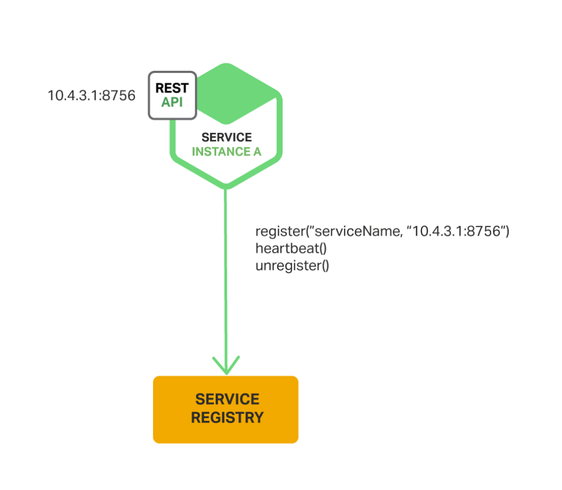
Service Registry
Database containing the network locations of service instances
Should be highly available
Instances self-register or are registered through a 3rd party registrar
Heartbeat confirms instances are still alive
Self-registration
Examples:
Netflix Eureka
etcd (Used by Kubernetes & Cloud Foundry)
Consul
Apache Zookeeper
Source: dzone.com
Notes:
Every mesh implementation will have some kind of service registry. The service registry is a simple key value pair data store, maintaining a current list of all working service instances and their locations. As each service instance starts up, it will register itself with the service registry, either through its own client code or through a 3rd party registrar function. For instance, your service instances might be implemented in containers that use the Kubernetes container cluster manager feature. Kubernetes provides a 3rd party registrar service for those containers in its clusters. Once a service instance has registered its existence with the service registry, the service registry will use some kind of heartbeat mechanism, either in-bound or out-bound, to keep its list of instances current. Since the service registry is so critical to the implementation, it needs to be made highly available in some way. In the examples box, you see the names of several implementations of service registry that you will find in the marketplace. The picture for this chart and the ones that follow are from dzone.com, an excellent source of additional knowledge on the workings of service registry and service discovery, which we will talk about next. At the end of segment 3 of this presentation, it is part of a short list of reference sites that I found useful in building this presentation.

Slide 12
Service Discovery / Service Proxy
Microservice
How client services find & connect to provider services
Each provider service provider could have multiple instances
The pool of instances and their locations can change:
Elasticity
Health management
Load distribution
2 Models
Client-side
Server-side
Client library
Microservice
Service
Proxy
Service
Registry
Microservice
app
sidecar
Notes:
The heart of any microservices mesh or mesh is the service registry and service discovery functions. These are the functions that enable each service to find and connect with the other services it needs to do its work. The source of all knowledge is the service registry. The service registry maintains a list of all service instances and their locations. As each service instance starts up, it checks in with the service registry, providing its name and location. After this initial check-in, each service registry implementation will have some kind of heartbeat mechanism to keep its list current, removing any instances it can no longer contact. Depending on the overall design of the application, each service instance could either be a service client, requesting data or functions from other services, a service provider, providing data or functions to service clients, or both. Whenever a service needs another service, it uses the service discovery function to find an instance of that service. The service discovery function works with the service registry function to make this happen. There are two basic types of service discovery functions that a given mesh could employ, client-side or server-side. I will describe each of these and how it works in the charts that follow. Looking at the picture on the right, it actually illustrates both types of service discovery and various ways of accomplishing each, so don’t expect to be able to understand or explain it now. You can come back to it after you have heard the rest of the presentation, and then you will be able to understand and explain it to your friends.

Slide 13
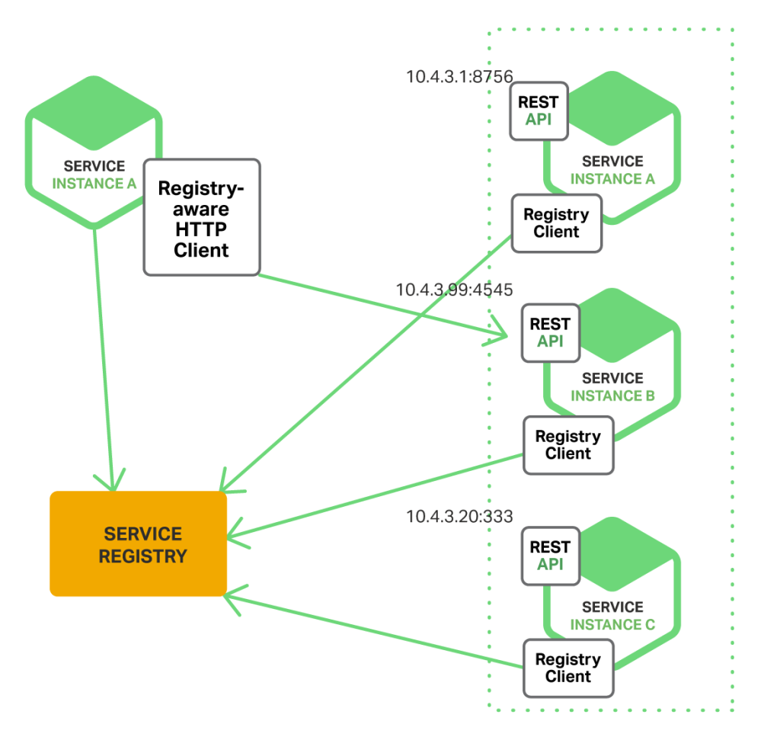
Client-Side Discovery
Client code is responsible for:
Finding locations of available service instances
Load balancing logic for requests
Client queries a service registry for location of service instances
Client uses its own load balancing algorithm to select which instance to request
Pros
Less components
Client can make application-specific load distribution decisions
Cons
Client load distribution logic needs to be developed for every language used
Logic changes need to be in code
Examples:
Netflix Eureka Service Registry
Netflix Ribbon IPC Client
Source: dzone.com
Notes:
The first type of service discovery we will talk about is client-side discovery. Using this method, the requesting service, or service client, works directly with the service registry to determine all the available instances of the service it needs, and then is also responsible for deciding which of those service instances it will use for its request. As I mentioned previously, there are several possible rules you could want to use to decide which instance to go to. You might be simply using round robin load balancing, where you spread each request evenly across all the instances, sending each request to the next instance in the list. Instead of that, you might be using a different kind of rule, having certain clients access certain provider instances, in order to test new versions or for some other reason. In any case, the point is that, with client-side discovery, the client service is responsible for making that decision itself, and following the decision to contact the appropriate service instance. The client will use some client code to make that happen. In the example box, you see that the Netflix Ribbon IPC Client, working with the Netflix Eureka service registry, is an example implementation of client-side service discovery. In the picture on the right, you see that the requesting service instance A on the left has found out from the service registry that there are 3 instances of the service it needs, shown on the right. Using whatever rule it has used to decide, the requesting service has decided to contact service instance B on the right for its request.

Slide 14
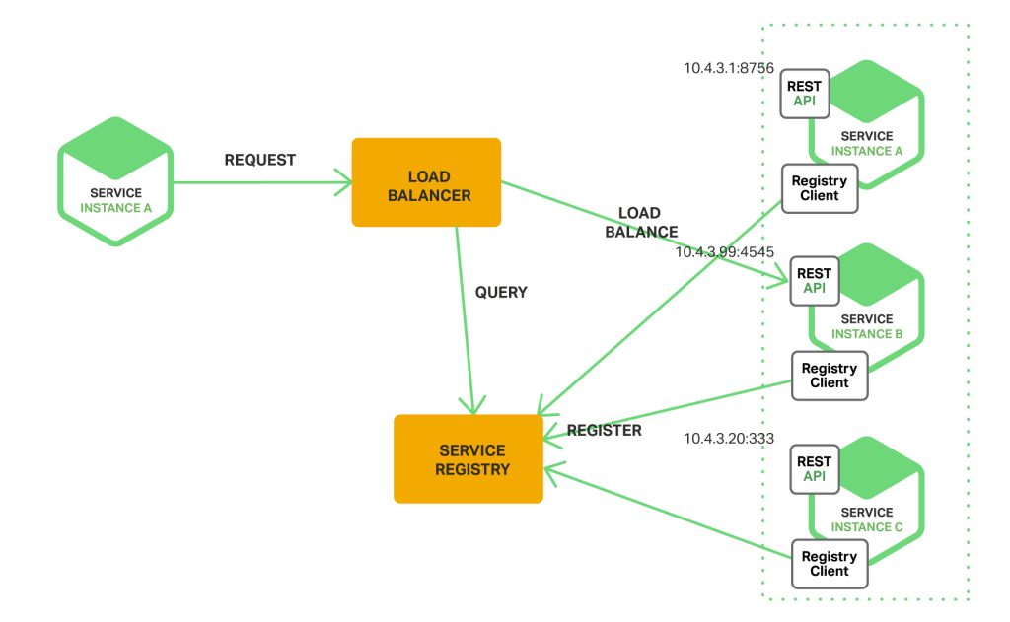
Server-Side Discovery
Client makes request to a load balancer
Load balancer queries service registry and routes requests to instances
Distribution logic in load balancer
Pros
Client does not need discovery & load balancing logic
Cons
Unless the load balancer is provided by the mesh, it is another component to manage
Examples:
AWS Elastic Load Balancer (ELB)
NGINX / NGINX Plus Http Server & Load Balancer
Istio
Source: dzone.com
Notes:
The second type of service discovery you will see is called server-side discovery. This method introduces another component, labelled the load balancer in the picture on the right, and also commonly called the service proxy in the microservices discussions. The task of querying the service registry and directing a request to the appropriate service instance is now delegated to the load balancer. In some implementations, such as Istio, the load balancer can be programmed with specific rules to govern its choice of service instance, beyond just using round robin load balancing. Some examples of this type of implementation are shown in the example box. You will find the NGINX load balancer built in to several mesh you might read about in the marketplace. A major benefit of this approach is that you only need to have the function of querying the service registry and directing requests to service instances implemented once, in the load balancer, rather than having to implement it in each service client and in each language. A possible drawback would be that the load balancer would be one more component for you to manage unless it is provided by your mesh. In most cases I’ve seen this is not a problem because the load balancer is provided by the mesh.

Slide 15
Server-side discovery built-in to Cloud Foundry & Kubernetes
The Cloud Foundry Cloud Controller and Router provide service registry and service discovery
Each service is a run time with a route
Cloud Controller manages service instances
Router distributes load across the service instances in round robin fashion
Blue-green deployment supports multiple versions of a service
Kubernetes Master Node provides service registry and service discovery
etcd provides service registry, assisted by kube-controller-manager
Endpoints controller and kube-proxy provide service discovery through the concept of a kubernetes service
Notes:
Granted, this is a little bit off topic. However, if you think about what you have probably learned by now about the Cloud Foundry architecture and Cloud Foundry runtimes, you will recognize that the functions of service registry and service discovery are really built in, even though they are not given those names. The Cloud Controller and the Router act as the service registry and load balancer. As applications are deployed with the number of instances requested, they are registered with the Cloud Controller. The Health Manager keeps track of the status of instances, reporting to the Cloud Controller. When an instance fails, the Cloud Controller acts to start up another instance to replace it. This is really the role of the service registry, actually a superset, since the Cloud Controller automatically replaces failed instances. The Cloud Foundry router acts as a server-side service discovery or service proxy, in that it distributes the load across the various instances. The blue-green deployment capability also can be used to support multiple versions of a multi-service. So, if you are working within a single Bluemix region, you have a little microservices mesh or fabric built in.
As the chart also says, if you want to expand the reach of your service beyond a single region, then you need to employ an external service registry such as Netflix Eureka or Apache Zookeeper. You can use the user-provided service capability of Bluemix to “bridge” your service running in the Cloud Foundry runtime to external services running in other Bluemix regions or elsewhere in the cloud.

Slide 16
Automated Testing
Test for failure
Purposely, randomly cause problems
Employ patterns for resiliency
Service Registry: Dynamic listing of service instances
Circuit Breaker: Block calls to a service that’s not working
Bulkhead: Separate connection pools for separate resources
Command: Make requests easy to retry, throttle, and monitor
Examples:
Netflix Chaos Monkey, Simian Army
Istio
Notes:
One of the premises of cloud native application development as well as microservices is that they should be designed to run on un-reliable systems. That is, you should expect components to fail and build resiliency into your applications such that they can withstand those failures. One of the basic design points of this strategy is to always have more than one instance of any given service, such that your application can survive the failure of a given instance and continue to function while that instance is restarted. There are other techniques to enhance resiliency, such as circuit breakers and bulkheads, which we will discuss in the following charts.
Another very useful tool in ensuring the resiliency of your microservices application is automated testing tools. Some examples of these are Netflix Chaos Monkey, the Netflix Simian Army and the features built into Istio that you will see later. A good place to start learning about Netflix Chaos Monkey and the Netflix Simian Army is the Netflix Tech Blog web site. The link to this site is provided on the Resources chart at the end of Part 3 of this presentation. Here is a brief description. Chaos Monkey is a testing tool that was originally designed to work with Amazon Web Services or AWS for short, but can be adapted to work in other environments. AWS has a facility called auto-scaling groups, or ASGs, in which multiple instances of a given service can be run and restarted on failure. Chaos Monkey can be pointed at one of these ASGs such that it will randomly terminate one of its instances, so you can make sure your application can continue to function. Chaos Monkey can be configured to only cause termination during regular business hours so that you make sure you have your full support staff on hand when the failure occurs. With the success of Chaos Monkey, Netflix has added a set of other monkeys to what it calls the Simian Army, including monkeys that test for conformity to corporate standards and shut down offending services, a latency monkey that adds network delays and tests for the application’s response, and a janitor monkey that looks for unused resources and shuts them down.
.

Slide 17
Circuit breaker
Consumer
Circuit breaker
Microservice
A service consumer is only as reliable as its service provider
Avoid invoking an unreliable service instance:
Service might throw an error
Service might time out
Network might fail
Circuit breaker
Consumer can invoke reliably
Invokes unreliable service
Fails fast when the service isn’t working
Connection problem
Timeout
Call timeout
Timeout
Call timeout
Circuit trips
Example:
Netflix Hystrix
Istio
Circuit open
Quick return
No call to microservice
Notes:
The circuit breaker pattern is a programming tool included with Netflix Hystrix that works to prevent response delays from a given service dependency, caused by failure or latency, from causing broader latencies and failures throughout the application. It allows you to set timeout thresholds and failure thresholds that allow you to “fail fast” from such situations, with the expectation of building a “Plan B” into your application. It works as shown in the diagram. Once you have defined your threshold numbers for timeout and timed out requests, if you make your service calls through Hystrix, and the thresholds are exceeded, the circuit trips and subsequent requests fail immediately, allowing you to follow the Plan B that you have hopefully built in to your application. You also configure a value for how long a recovery time you allow before opening the circuit again, trying a call to the service again, and testing your thresholds.

Slide 18
Bulkhead
No bulkhead
User action
No bulkhead
Single connection pool shared to connect to multiple external systems
If one system blocks connections
All connections block on the one system
No way to connect to the working systems
Bulkhead
Separate connection pool for each external system
If one system blocks connections
All its connections block
Meanwhile, connections to the working systems still work
Shared connection pool
Legacy system 1
Legacy system 2
Bulkhead
User action
Connection pool 1
Connection pool 2
Example:
Netflix Hystrix
Istio
Legacy system 1
Legacy system 2
Notes:
The Bulkhead pattern is another tool included with Netflix Hystrix that also prevents response delays from a given service call from causing wider problems throughout the application. This is accomplished by using separate thread pools for connection attempts to other systems, such that delays called by latency or failure of a given service are isolated to that service and do not end up using all the threads for the application as more and more requests are made. By using separate connection pools for each dependent service, failure on any service is isolated to that service and does not cause broader issues in the application.
There are very good descriptions and examples of how circuit breakers and bulkheads work in the Github repository for Netflix Hystrix.
This concludes part 2 of the presentation, where we went through the generic functions that you will typically find in a microservices mesh or fabric. Not all mesh have all functions, but you are always free to mix and match, to use the functions from whatever mesh that best fit the requirements of your application.
In part 3 of this presentation, I will take a closer look at 2 implementations of microservice mesh, Netflix OSS and IBM Amalgam8.

Slide 19
Services Mesh Implementations
Netflix OSS
Istio
Notes:
In this third and final part of the presentation, I will give you a brief introduction to some example implementations of service mesh, Netflix OSS and Istio.

Slide 20
Notes:
The first example is the Netflix Open Source Software set of tools. Netflix have been real trail blazers in the use of microservices, and they have open sourced many of the tools they used and continue to enhance.

Slide 21
What is Netflix OSS?
Netflix OSS – A software-based control plane that is portable across clouds, can be run the same locally on a laptop or in any number of public Cloud providers.
Netflix is the “poster child” of microservices
Netflix OSS is open source of many of the tools and methods they have used to build and improve their site
Over 33 root-level projects (and more actively maintained)
Most are Java libraries – Class structure could restrict you to only running your code in their framework
Netflix OSS components available via https://netflix.github.io
Notes:
Netflix are widely considered to be the poster child of microservices. The highly personalized experience they are able to deliver from their site, when accessed from a variety of different devices, is really remarkable. They have open sourced and shared many of the tools they used to implement microservices at the Netflix Open Source Software Center site. Each of the tools is well described in their Github repository and also in the Netflix Tech Blog, which I reference at the end of the presentation.
The Netflix tools are probably the most popular set of microservices mesh or fabric tools in use across the industry today. Here I will highlight just a small subset of the over 33 projects available.

Slide 22
Major Netflix OSS Projects
Service Registry / Discovery / Proxy – Eureka, Ribbon, Zuul
Client-side discovery – logic built into application libraries
Many applications automatically integrate with Eureka (or are enabled to through the use of Spring Cloud enhancements)
Failure Testing – Chaos Monkey, Simian Army
Chaos Monkey was the first project
Simian Army includes Chaos Monkey and an “army” of other monkeys
Latency Monkey, Conformity Monkey, Doctor Monkey, Janitor Monkey, Security Monkey, and more
Programmatically control what parts of their infrastructure are unstable, unavailable, and unreliable
See how this impacts overall system health.
Original Chaos Monkey was built to the AWS APIs
Other parts of the Simian Army not written to specific provider APIs
Notes:
The Netflix collection of service discovery projects are probably the most prevalent in use today. In our previous description of service discovery, we mentioned Eureka service registry and the Ribbon IPC service discovery client. We have not yet talked about Zuul. Zuul is an edge service, designed to front end the Netflix API’s and servers. Zuul uses a set of filters to control and analyze the traffic that flows through it, and perform several useful functions. The filters are in 4 broad categories. Pre filters handle authentication, choosing servers to send requests to and collect debugging information. Routing filters actually route requests to the backing services. Post filters perform functions such as adding http headers to responses and collecting metrics. Error filters are triggered to handle error conditions. Zuul has a mechanism for filters of these 4 categories to be added and updated, providing a way to configure load balancing, A/B testing, routing around failures and performance analysis. Many applications, including the Netflix on Bluemix examples mentioned on the previous chart, are automatically integrated with Eureka service registry or are enabled to through the use of Spring Cloud enhancements.

Slide 23
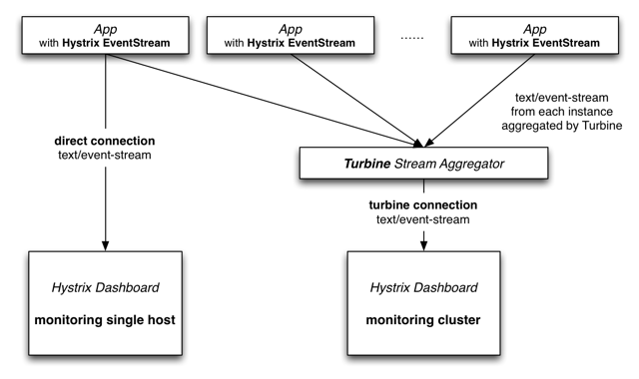
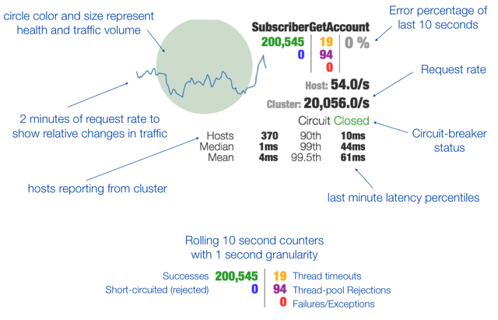
Netflix OSS Circuit Breaker – Hystrix, Turbine, Hystrix Dashboard
Java-based implementation of the Circuit Breaker pattern
Provides reliability beyond individual service calls & visibility into hot-spots / bottlenecks
Isolates latency and increases fault tolerance at runtime
Turbine aggregates clustered services into a single stream for visibility through Hystrix Dashboards
Source: techblog.netflix.com
Notes:
We talked about the circuit breaker pattern included in Netflix Hystrix in the previous part of the presentation. You will remember that the circuit breaker enables you to configure and enforce timeout and retry thresholds for service calls that will prevent your application from blocking on repeated calls to a failed or low-performing service. The Hystrix Dashboard, and Turbine in the background, provide a visual view of the traffic volumes and performance to services. It also shows if a circuit breaker has been tripped as you can see on the right side of the dashboard display. Turbine works behind the scenes for the Hystrix dashboard, aggregating results for a given service call from multiple servers or clusters of servers to achieve a single result on the dashboard. As you can see, Hystrix, through its circuit breaker and bulkhead patterns we previously described, and through its dashboard that you see on this chart, is a very useful tool for enhancing and visualizing the resiliency of your microservices application.

Slide 24

http://istio.io
Notes:
Next we will learn about the emerging service mesh project that IBM is a contributor to, Istio. Istio is a Greek word meaning to sail. This fits well with the nautical imagery associated with Kubernetes container orchestrator, which is the first platform where Istio is implemented.

Slide 25
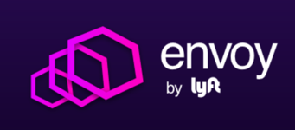


Evolving Service Mesh
Istio
Rate limiting
Secure Communication
Request Tracing
Circuit Breakers
Community
Content-based routing and failure injection for polyglot microservices
High performance service proxy
https://github.com/istio
Notes:
Istio is an open source service mesh project where IBM is a major contributor, along with Google and Lyft. In mid-2016, IBM was working on a service mesh project called Amalgam8. Some discussions between IBM and Google representatives revealed that Google was working on some similar projects with a similar mindset, with a focus on security and visibility of activity within a container cluster. At the same time, Lyft, as part of their microservices implementation, had developed a high performing and functional application traffic router or proxy called Envoy. IBM, Google and Lyft decided to join forces, and in May of 2017 publicly announced the Istio project. Since then, there has been a tremendous amount of interest and contributions from various sources.

Slide 26
Intelligent Routing and Load Balancing
Control traffic between services with dynamic route configuration, conduct A/B tests, release canaries, and gradually upgrade versions using red/black deployments
Notes:
So what does Istio give you? It provides you with the ability to intelligently control the routing of messages and requests between services in your application, and to do that using policy. You can implement a policy or policies in a single place that controls how services find and talk to another. No configuration is required at the level of the service, in fact the service does not even know about the existence of the mesh. Your policy can implement a variety of different policies. For instance you can maintain multiple versions or flavors of a certain service. You can direct the traffic from one source or set of sources to one version and from other sources to another. The source can be identified by geographic origin, device type, or any variety of other characteristics. You can also direct a certain blanket percentage of the traffic to one version versus another version. You can see how powerful this capability can be and how easily a change in policy can be implemented across the many services that might comprise your application. One of the common uses would be in red/black deployments, where you could incrementally introduce and test a new version of a service while maintaining the original version in place.

Slide 27
Resilience Across Languages and Platforms
Increase reliability by shielding applications from flaky networks and cascading failures in adverse conditions
Notes:
There are actually 2 ideas on this chart, resiliency and language independence. We will talk about language first. One of the design points of Istio was to make it language agnostic. That is, it could work no matter what languages the services it manages were written in. In contrast to Netflix OSS, which is implemented as code libraries and mostly is restricted to Java applications, Istio is implemented in Kubernetes by the use of companion containers called sidecars. More about sidecars later. The sidecars intercept the communications between the containers housing the services, and direct those communications based on the policy that has been loaded. It doesn’t matter what language the service is written in, or how many languages are used across the application. The mesh performs its function through the sidecars the same way.
The second point on this chart is about resilience. One of the realities in microservice applications is occasional failures or network delays between services. With Istio, you can implement the circuit breaker pattern to deal with service timeouts and failures, and you can inject artificial delays in communications to test that your service timeouts are compatible with each other. That as a whole, the application is resilent in fhe face of these failures and delays,

Slide 28
Fleet Wide Policy Enforcement
Apply organizational policy to the interaction between services, ensure access policies are enforced and resources are fairly distributed among consumers
Notes:
Istio provides you with fleet wide policy enforcement. This is a very powerful idea and capability. The fact that the policy is implemented across the board, external from the code of any of the services, means that you can easily enforce a consistent policy across the breadth of your application. It also avoids the potential duplication and inconsistency of each service developer needing to build these policies into their code.

Slide 29
In-Depth Telemetry and Reporting
Understand the dependencies between services, the nature and flow of traffic between them and quickly identify issues with distributed tracing
Notes:
The final major benefit that Istio deliveries is the built-in ability to get visibility and reporting of the performance of services and the flow of traffic between them. There are graphical views and other reporting that can be turned on to display the metrics of the interactions between services, information that can be reported back to the control plane by the sidecars.

Slide 30
Managing services: Proxy and sidecar
Proxy
A service mesh manages the interactions between services
It uses proxies, usually deployed as sidecars in pods
Proxy – Controls access to another object
A service mesh uses proxies between services (and also clients)
Enables the mesh to manage interactions
Pod – Kubernetes deploys a set of containers as a pod
All of the containers in a pod are hosted on the same node
A pod can manage the network access to the containers in the pod
A pod typically hosts a single container, but can host multiple as a unit
Sidecar – Adds behavior to a container without changing it
Sidecar and service behave as a single enhanced unit
Pod hosts them as a single unit
Mesh Member – Access to the service goes through the proxy
Deploys the proxy as a sidecar in the same pod
Configures the pod so that all network access goes through the proxy
proxy
service
Sidecar
Pod
sidecar
service
Mesh Member
Pod
proxy
service
Notes:
This is a set of definitions that will make it easier to understand how Istio works. The first thing to say is that the first implementation of Istio is in the Kubernetes container orchestration project. The implementation details will align with the capabilities of Kubernetes.
As we have said before, a service mesh provides its value by managing the interactions between services. If you know anything about Kubernetes, there is a capability within Kubernetes called “services”. This is not what we are talking about here. When we say “services” in this context, we are talking about the generic services that make up an overall cloud-native application. Usually these services are also referred to as microservices. The way Istio provides its value is by managing the interaction between these services by use of a proxy.
A proxy intercepts messages between services and applies one or more policies to the way they are delivered. The actual services do know know about the existence of the proxy. They just make their requests and receive their results without any knowledge of what the proxy is doing. The power of this approach is that you can modify the policy without ever having to change any of the code or logic of the services themselves.
A pod is the mechanism that Kubernetes uses to deploy containers. In Kubernetes, each application service is deployed as a container into a pod. Each pod typically has one application container and could have one or more “sidecar” containers. Sidecar containers are used to apply some kind of management function to the behavior of the application container. Sidecar containers can be used for monitoring, logging, or other management functions. In the case of Istio, the proxy function is implemented by use of a sidecar.
As a mesh member, the application container (labeled as “service” in the picture) has its communications intercepted by the proxy, which applies the appropriate policy as it delivers the communication to the target service.
Later in the presentation, we will be showing some examples of what these policies could be. For now, just understand that policies can be applied and modified without any knowledge of the “mesh member” services. This separation is achieved by implementing the proxy function as a sidecar in the pods that house each application service instance.

Slide 31
Mesh Request Flow
HTTP/1.1, HTTP/2, gRPC, TCP
HTTP/1.1, HTTP/2, gRPC, TCP with or without TLS
Pod
Pod
Internet
External Services
proxy
proxy
proxy
Ingress Proxy
(Kubernetes ingress controller)
service A
service B
Service A
Service B
Inbound features
Service authentication
Authorization
Rate limits
Load shedding
Telemetry
Request Tracing
Fault Injection
Outbound features
Service authentication
Load balancing
Circuit breaker and retry
Fine-grained routing
Telemetry
Request Tracing
Fault Injection
Notes:
As we said before, the mesh is implemented using proxies. You want your proxies to handle both ingress and egress traffic to a service. Ingress and egress are terms that originate in real estate law. They refer to the rights of a person to enter and leave a property. In a similar way, the Istio mesh manages the communications of services and users under its control.
The use of proxies allows you to bake several desirable properties into the service mesh:
You can offload common functions performed inside the application code into the proxy (such as telemetry, distributed tracing, TLS termination/initiation, etc.).
You can also add more useful features in the proxy, such as circuit breakers, rate limits, intelligent routing for A/B testing, canary releases, etc.

Slide 32
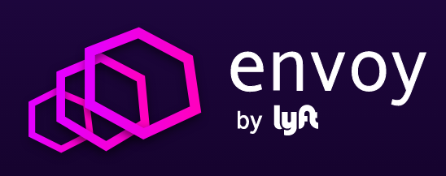
Envoy: Istio’s proxy of choice
A C++ based L4/L7 proxy
Low memory footprint
Battle-tested @ Lyft
100+ services
10,000+ VMs
2M req/s
Now a Cloud Native Computing Foundation open source project (CNCF)
Not unilaterally controlled by Lyft or Istio
Many contributors
https://www.envoyproxy.io & https://www.cncf.io/blog/2017/09/13/cncf-hosts-envoy
Goodies:
HTTP/2 & gRPC
Zone-aware load balancing w/failover
Health checks, circuit breakers, timeouts, retry budgets
No hot reloads - API driven config updates
Istio’s contributions:
Transparent proxying w/ SO_ORIGINAL_DST
Traffic routing and splitting
Request tracing using Zipkin
Fault injection
Notes:
We decided to build our service mesh on top of Envoy, the proxy built by the folks at the ridesharing company Lyft. Lyft had been operating their own microservices application using Envoy at a large scale for over a year. Out of the box Envoy came with a lot of features that were very desirable as part of Istio.
We loved the simplicity of design, extensibility, feature set and of course performance. But what was and will be important to us is the team itself: their openness to ideas, willingness to work with the community to add various features that we wanted. It was a win-win situation.
We have been working extensively with the Envoy team over the last 7 months adding various features (such as traffic splitting, zipkin tracing, fault injection, some of which also went into production at Lyft.
Envoy from Lyft is now a CNCF (Cloud Native Computing Foundation) open source project, which facilitates contributions from other organizations beyond Lyft (https://www.envoyproxy.io).

Slide 33
Istio Control Plane
Control Plane API
Control flow during request processing
Istio-Manager
Mixer
Istio-Auth
Discovery & Config data to Envoys
TLS certs to Envoy
Policy checks, telemetry
Pod
Envoy
Envoy
Traffic is transparently intercepted and proxied. App is unaware of Envoy’s presence
svcA
svcB
Service A
Service B
Notes:
Our service mesh is built using Envoy proxies. If you look at the big picture, it is very similar to a Software Defined Network (SDN).
Traffic is transparently intercepted by the Envoy proxies using iptable rules in the pod namespace.
The Istio control plane takes care of managing and configuring the data plane.
The Istio-manager is responsible for providing service discovery to envoys and managing their configuration as well.
The mixer handles policy enforcement, while Istio-auth takes care of authentication and authorization.
We’ll talk about the mixer and Istio-auth later.

Slide 34

Traffic Splitting
serviceB.example.cluster.local
// A simple traffic splitting rule
destination: serviceB.example.cluster.local
match: source: serviceA.example.cluster.local route: - tags: version: v1.5
env: us-prod
weight: 99
- tags: version: v2.0-alpha
env: us-staging
weight: 1
Rules API
Pod Labels:
version: v1.5
env: us-prod
Istio-Manager
Traffic routing rules
99%
Envoy
Pod
Envoy
svcB
Service B
http://serviceB.example
1%
svcA
Envoy
Service A
svcB
Traffic control is decoupled from infrastructure scaling
Pod Labels:
version: v2.0-alpha, env:us-staging
Notes:
Traffic control is decoupled from infrastructure scaling - i.e., the proportion of traffic routed to a version is independent of number of instances supporting the version
You can program these traffic routing rules using istio on the fly using simple rules as shown in the slide. These rules get translated into low level Envoy configs. Envoy periodically fetches configs from the manager and updates its internal routing table. There are no hot restarts, no impact to existing traffic.
We call this tag based routing.

Slide 35
Traffic Steering
Service B
version: v1
// Content-based traffic steering rule
destination: serviceB.example.cluster.local match: httpHeaders: user-agent: regex: ^(.*?;)?(iPhone)(;.*)?$ precedence: 2 route: - tags: version: canary
Pod 1
Pod 2
svcA
Pod 3
Service A
svcB
Service B
version: v1
Pod 1
User-agent: *Android*
Pod 2
Pod 3
svcA
svcB
Service A
User-agent: *iPhone*
Content-based traffic steering
Pod 4
svcB’
version: canary
Notes:
Content-based traffic steering - The content of a request can be used to determine the destination of a request
Another way to route requests is the age old method. Look at the contents of a request and route it to a specific set of instances. This opens up all sorts of possibilities. For a user facing service, you could route a portion of mobile traffic from a particular device, say an iPhone, to a specific version of the service. For internal services, callers would have the ability to explicitly request a particular version of the service. In fact, Verizon is using this particular technique in production today.

Slide 36
Resiliency
Istio adds fault tolerance to your application without any changes to code
// Circuit breakers
destination: serviceB.example.cluster.local policy: - tags: version: v1 circuitBreaker: simpleCb: maxConnections: 100 httpMaxRequests: 1000 httpMaxRequestsPerConnection: 10 httpConsecutiveErrors: 7 sleepWindow: 15m httpDetectionInterval: 5m
Resilience features
Timeouts
Retries with timeout budget
Circuit breakers
Health checks
AZ-aware load balancing w/ automatic failover
Control connection pool size and request load
Systematic fault injection
Notes:
In our experience working with a diverse set of clients, 95% of them are happy with an out of process sidecar implementing all the resiliency features such as circuit breakers instead of having to build them into the application code.
Secondly, in most of the cases, there is a fair amount of parameter tweaking - e.g., making sure that timeouts across services are not too tight or ensuring that a circuit doesn’t open too early.
Istio provides dynamically configurable resilience features that you can tweak at runtime, *in production*.

Slide 37
Resiliency Testing
Systematic fault injection to identify weaknesses in failure recovery policies
HTTP/gRPC error codes
Delay injection
Timeout: 100ms
Retries: 3
300ms
Timeout: 200ms
Retries: 2
400ms
Envoy
Envoy
Envoy
svcA
svcB
svcC
Service A
Service B
Service C
Notes:
Systematic resilience testing allows you to test the ability of your services to recover from failures. You can isolate failures to specific subset of requests (such as those coming from QA teams), while running these tests in production.
Consider a scenario where a chain of service calls has incompatible timeouts and retries. You can always recover from these issues by using timeouts/retries/circuit breakers on the very first service in the call chain. But think of all the wasted work in the backend services (resources being held up).
Worse yet, think of the impact on your users. For example, consider Netflix recommendations. When the system is running well, you get personalized recommendations. That is a “feature”. When the personalized recommendations system is down, Netflix falls back to “generic recommendations”. This is great as long as the outage is temporary. But this could become the permanent user experience for weeks at a time, because some frontend system had a misconfigured timeout that caused it to prematurely terminate API calls to the recommendation engine. Having the ability to inject artificial delays into various service boundaries in your application helps you avoid this situation. By making sure the timeouts of your various services are delivering the desired outcome under load or failure conditions through testing, you can increase the resiliency of your application.

Slide 38
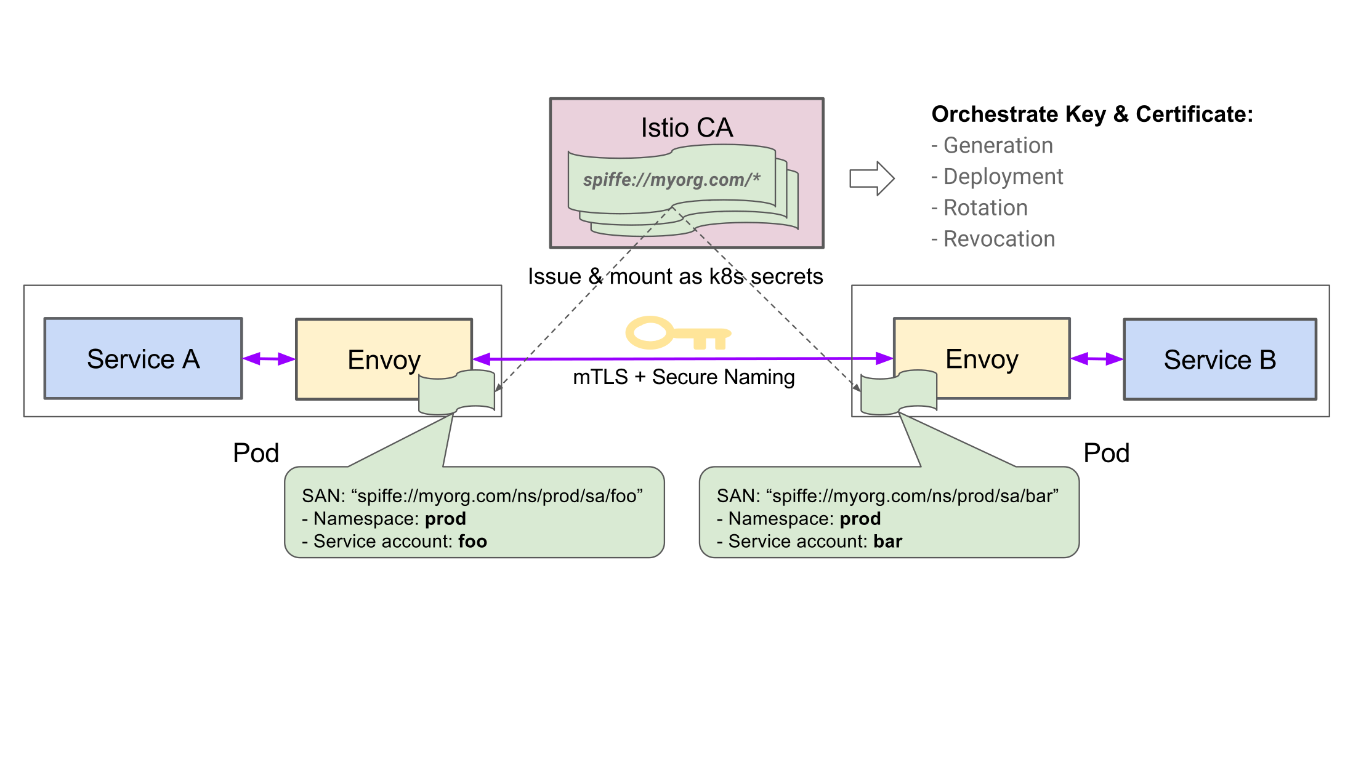
Istio Auth Service Authentication Architecture
spiffe.io
Notes:
Walk through the flow
Istio CA deployed that mints certs for K8S service accounts
Certs are associated with resource UIDs that adhere to the SPIFFE spec
Certs are distributed to Envoy proxies using K8S secrets
Envoy uses keys to enable mTLS without application involvement
Identities are propagated to backends via standard headers
Policies can be enforced on these identities
Defense in depth - Certificates are automatically rotated, can be revoked
Defense in depth - Secure naming - prevent DNS spoofing attacks by associating service-account with name.
Setup responsive to K8S autoscaling
no need for manual intervention
no need for firewalls - can have a completely flat network
Next steps
Integrate certificate management & storage systems (e.g. Vault, HSMs etc)

Slide 39
Conclusion

Slide 40
Conclusion
Why service mesh?
Common functions of a service mesh
Services mesh implementations

Slide 41
Resources
IBM, Google and Lyft give microservices a ride on the Istio Service Mesh
https://developer.ibm.com/dwblog/2017/istio/
Istio
https://istio.io
https://github.com/istio
developerWorks Container Orchestration Journeys
http://ibm.biz/kube-journeys
https://developer.ibm.com/code/journey/manage-microservices-traffic-using-istio
Microservices
http://kasunpanorama.blogspot.com/2015/11/microservices-in-practice.html
Service discovery
https://dzone.com/articles/service-discovery-in-a-microservices-architecture
Service mesh
https://blog.buoyant.io/2017/04/25/whats-a-service-mesh-and-why-do-i-need-one/
https://content.pivotal.io/blog/pivotal-and-istio-advancing-the-ecosystem-for-microservices-in-the-enterprise
Sidecars
https://blog.buoyant.io/2016/06/17/small-memory-jvm-techniques-for-microservice-sidecars/
Notes:
This is a fairly short list, but I think a good list, of some of my favorite sources of knowledge in building this presentation. If you download the presentation, you will be able to follow the hot links, and I hope you find them as useful as I did. I’ve tried to designate which particular subjects each link has the best information on.

Slide 42
Backup Slides

Slide 43
Istio Advantages
Intelligent Routing and Load Balancing
Control traffic between services with dynamic route configuration, conduct A/B tests, release canaries, and gradually upgrade versions using red/black deployments.
Resilience Across Languages and Platforms
Increase reliability by shielding applications from flaky networks and cascading failures in adverse conditions.
Fleet Wide Policy Enforcement
Apply organizational policy to the interaction between services, ensure access policies are enforced and resources are fairly distributed among consumers.
In-Depth Telemetry and Reporting
Understand the dependencies between services, the nature and flow of traffic between them and quickly identify issues with distributed tracing.

